Slide 1
CAR LAUNCH DATASET ANALYSIS IN UK MARKET
Presented By : Ankit Dhole & Satyam Parihar

Slide 2
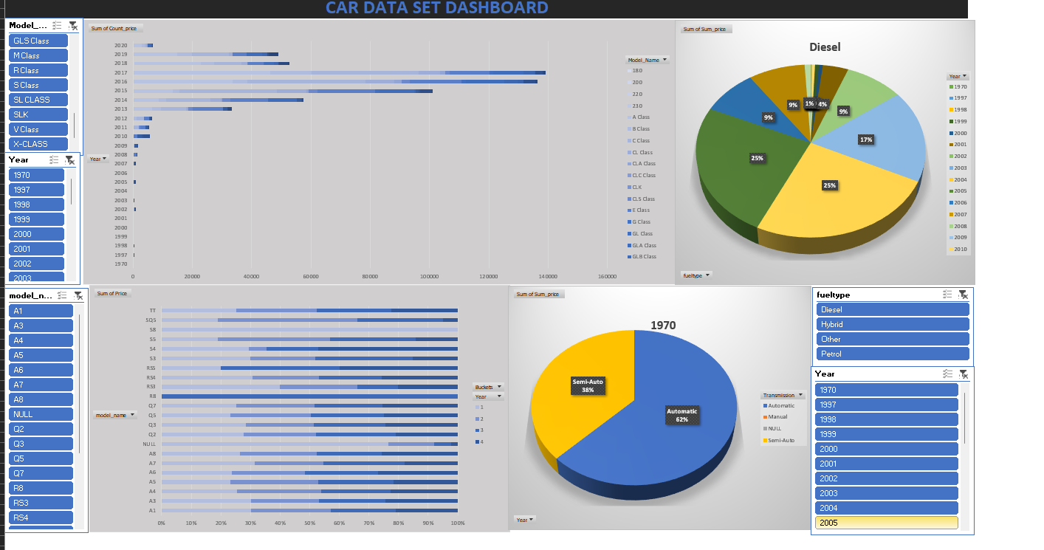
DASHBOARD

Slide 3
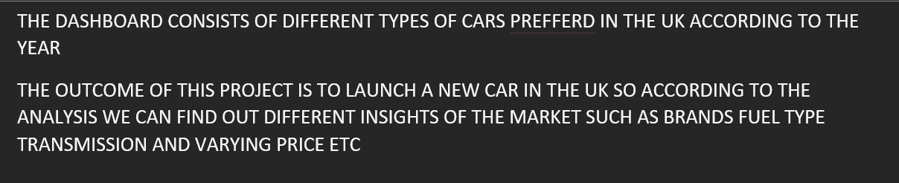




INSIGHTS (Metadata)

Slide 4
The sum count of price of cars according to models and their changes in the years
The changes according to the year and cars(model) started to develop a lot of features and hence vintage came to an end and new cars started to develop a good hold in the market
So there`s a change in price in cars according to their models and advancement year by year and that’s what this bar graph and can also be seen on the dashboard
And it is visible on this bar graph Mercedes G CLASS And Further Advancement Is Holding a good position in the market

Slide 5
CATERGORIES OF CARS(MODEL) BASED ON PRICE(bucket)
The cars are categorized under price medium and hence different cars have different models and according to that model a clustered bar graph is shown in this slide and also depicted On the dashboard
So as seen on the bar graph we can see the bucket 4 has high value of cars and all the buckets are sorted accordingly as per the price and advancement of the cars and we have 4 buckets where bucket 1 2 3 4 are sorted accordingly to the price of car
This chart consist of year buckets and all the models of cars and their values so with the help of slicer we can find out details of years buckets and model name of car

Slide 6
FUEL TYPE (efficiency and price of cars/sales of cars /fueltype)
This graph shows the fueltype that cars is using and hence the value of price according to the car
The pie chart is also shown in the dashboard and depicts the value of fuel types and their changes according to year starting from 1970 to update and their changes over time
Currently, it is set to diesel and have more different variants such as petrol hybrid electric etc And the use of these fueltypes according to the year

Slide 7
Transmission (3) And their change according to the year
As we can see this pie chart that is on the right shows the transmission according to the changes over years and different transmission that are commonly used can also be seen on the dashboard by using slicers of year and fuel type
Some of the mention transmissions are semi-automatic manual and automatic

Slide 8
Prices of car sorted according to UK citizen
This graph shows the clasess that cars is using and hence the value of price according to the car and the number of car (count) sold according to year

Slide 9
PRICES OF CAR ACCORDING TO YEAR & THE TYPES OF TRANSMISSION
This graph shows the transmission that cars is using and hence the value of price according to the car and the number of car (count) sold according to year

Slide 10

THANK YOU

